Slide 1
Active Noise Control
By: Julie Swift
Advisor: Larry Pearlstein

Slide 2
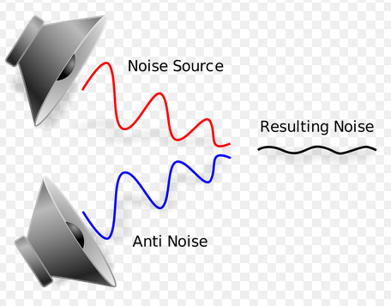
Overview
“Anti-Noise” Signals
Examples of Application
Night Club
Hearing Impairment
Notes:
ANC systems use the concept of Anti-Noise that is then added to the noise source resulting in a softer, less prominent noise signal
The concept of this application would be used in places that are loud, such as in a night club, where people would want to talk and cancel out the ambient background noise in order to hear the desire signal, such as a waitress speaking.
This concept can also be used for hearing impaired individuals whose lack the ability to focus out background noise when trying to converse with people in their proximity

Slide 3
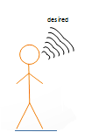
Stylized Application Scenario
Room Acoustics
Notes:
This diagram explains the basic overview of our Active Noise Control system.
We use DSP Processing that would act as the adaptive canceller that ideally filters out background ambient noise to help the listener hear the desired signal more clearly

Slide 4
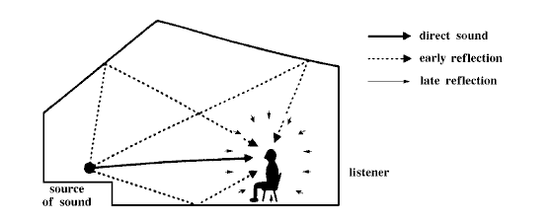
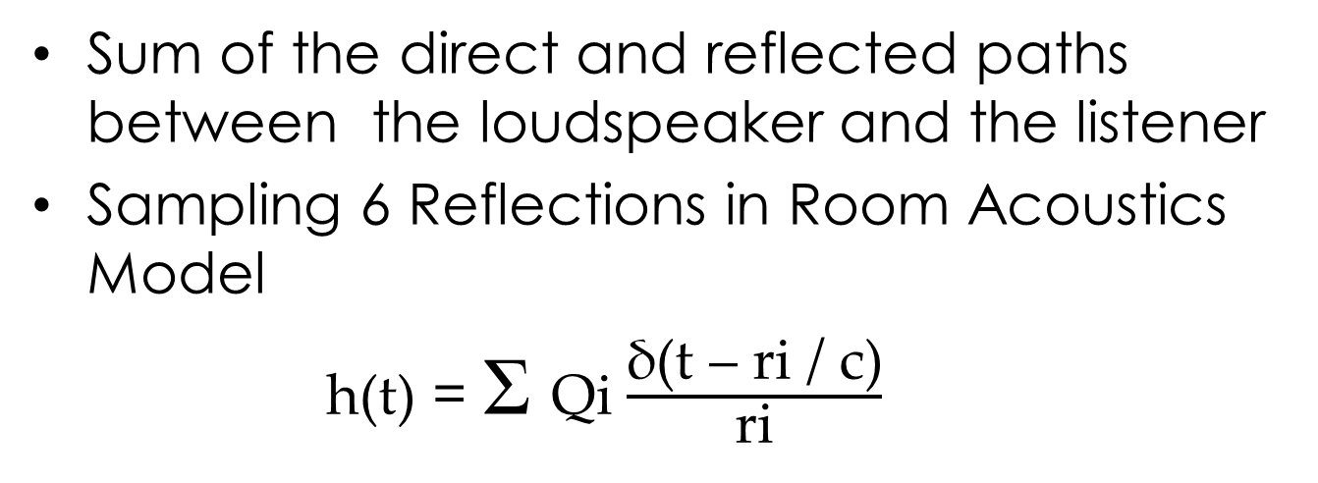
Modeling the Acoustics of a Room
Sum of the direct and reflected paths between the loudspeaker and the listener
Sampling 6 Reflections in Room Acoustics Model
h(t) = Ʃ Qi $\frac{\text{δ}\text{(}\text{t}\text{ – }\text{ri}\text{ / }\text{c}\text{)}}{\text{ri}}$
Notes:
• Qi - image source strength
• ri - source distance
• Delta-function generates a peak in IR at arrival time ri / c
Simple model based on a sum of the direct and reflected paths between the loudspeaker and the listener

Slide 5
LMS Block Based Approach
Produces Output Signal and Estimated Error
Uses Error Signal to Adjust the Filter’s Tap Weights to Create an Adaptive Filter
Adaptive Canceller
Desired signal trains the filter
System Identification-the combined response of mic model and hs model

Slide 6
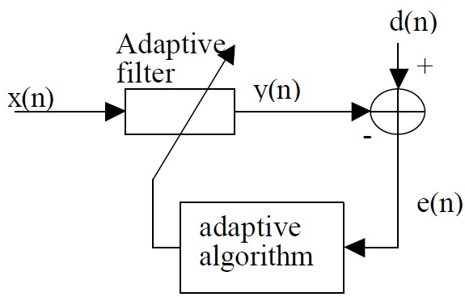
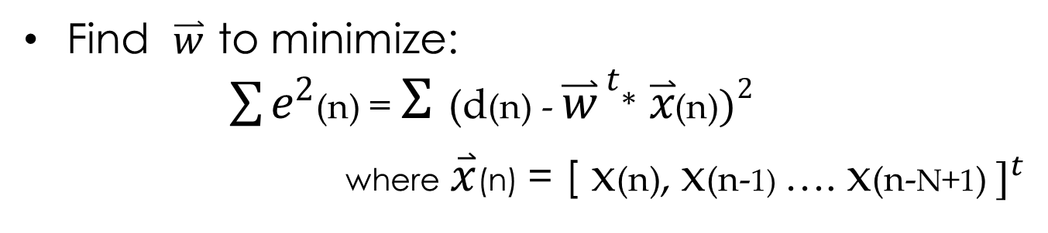

Least Mean Square Algorithm
Find $\overset{⃑}{w}$ to minimize: $\sum{e^{2}}$(n) = $Ʃ$ (d(n) - ${\overset{⃑}{w}}^{ t}$* $\overset{⃑}{x}$(n)$)^{2}$
where $\overset{⃑}{x}$(n) = [ x(n), x(n-1) …. x(n-N+1) $]^{t}$
$$\overset{⃑}{w}$$
Notes:
Where X(n) is a vector of recent samples
If optimum w wasn’t changing, there would be a closed formed solution; however w is constantly changing hence the need for a feedback system
Take impulse response and filter signal from that in the feedback path
Difference between y and d is close to zero
Sum total of all the noise we force to zero

Slide 7
Theoretical Optimization Problem
Normalized LMS
rs = multiply recent_samps by transposed version
For the length of the filter order (150)
Model_coeffs – mu * e * recent_samps /(0.000001 + rs);
Mu
Step Size descending down the parabola
Closer to optimum of parabola
Two tap filter (2 dimensional)
Notes:
Normalized LMS
Sum of Squares of output
Filtered x LMS algorithm

Slide 8
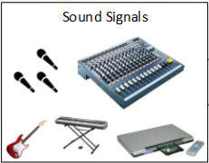
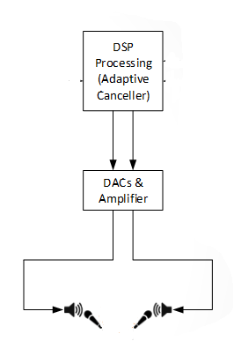
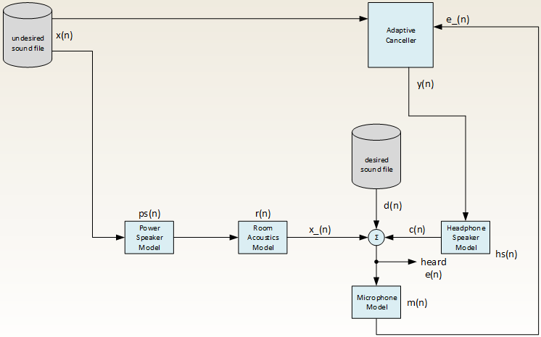
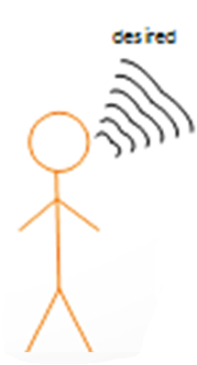
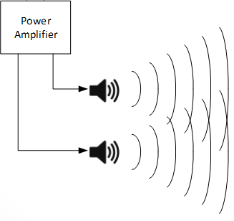

Model
Ideally c(n) = - x_(n)
Notes:
This ANC model illustrates the partitioning of the matlab code
Undesired-ambient background noise—in our case is Beethoven’s Fur Elise or 5th Symphony
The undesired signal is then passed through a power amplifier to the listener
This process of the listener hearing the undesired signal is modeled by loudspeaker model and the room acoustics model. The room acoustics model mimics the environment around the listener. It would be based on the rooms dimensions, whether it has carpet or not, and where the listener is standing in the room.
The desired noise—in our case is Obama’s Congressional Speech—is then also heard by the listener.
The Adaptive Canceller uses this anti-noise concept to subtract the undesired sound, ideally eliminating x_(n) in order for the listener to just here the desired signal

Slide 9


MATLAB Variables
e(n) = x_(n) + d(n) + c(n);
e(n) = Waveform Heard by Listener
x_(n) = Undesired Signal at the Listener
d(n) = Desired signal
c(n) = Output signal coming out of the Headphone Speaker Model
Mu 0 error signal
Mu 0.01 error signal

Slide 10
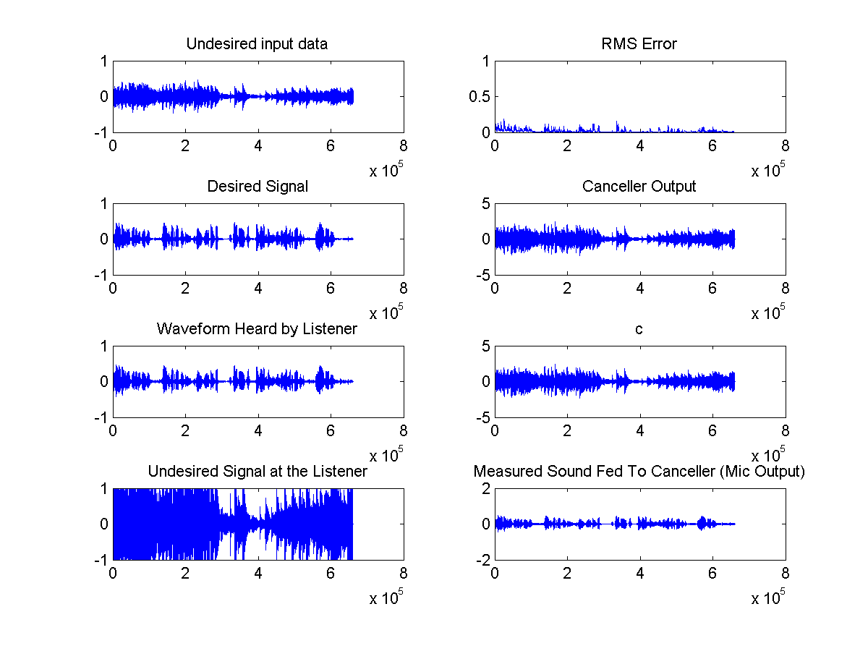
Simulation

Slide 11
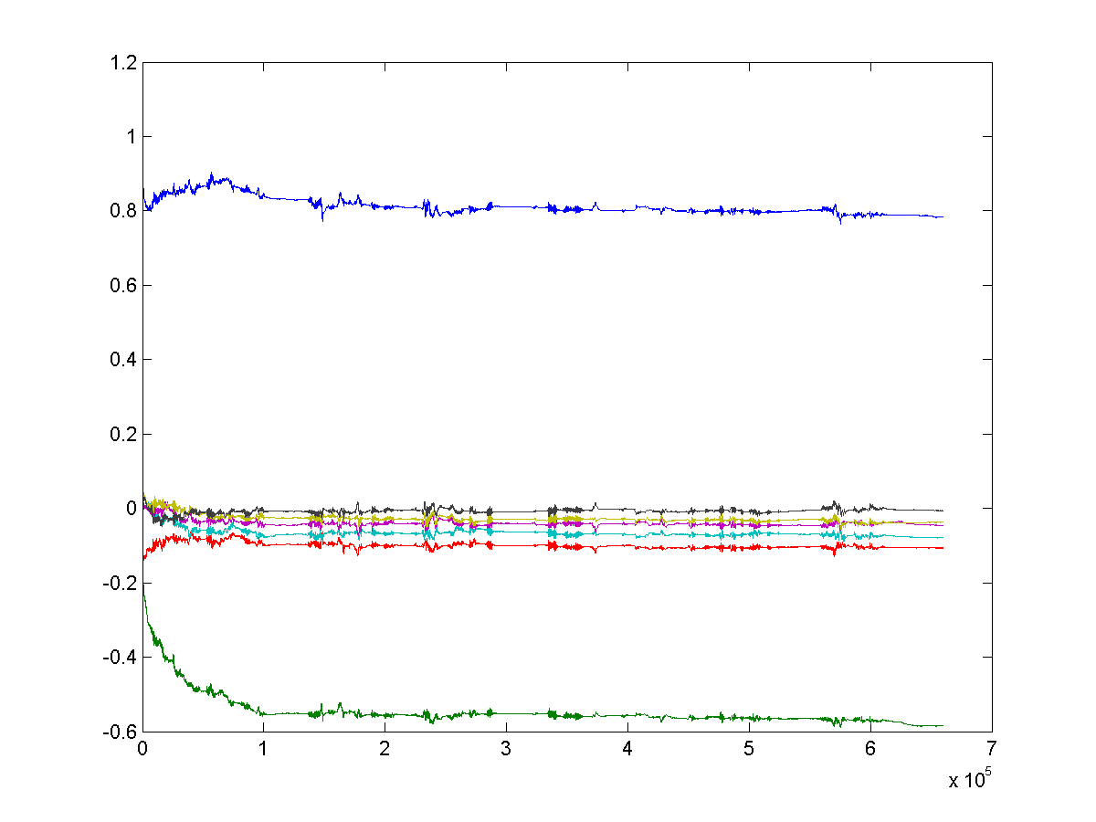
Simulation Evolution of Tap Weights
Value of Filter tap weight
Finite Impulse Response
Time

Slide 12
Matlab processing for PSOC
30,000 random samples (d) —remove first 50 samples
30,000 random PSoC generated samples (x)
Subtract the mean of each sample from itself
For the number of sub-segments of length N that we can make from d, stepping by one, such that all samples of each sub-segment are fully contained in d
Normalize accumulate auto and cross-correlation
Compute impulse response to produce the least sum-of-squares discrepancy between x filtered by w, and d

Slide 13
Conclusion
Basic architecture of the ANC model
Automated experimental process created in PERL
Future Works:
Adapting quicker
Testing without perfect Impulses

Slide 14
References
[WID1975] Widrow, Bernard, et al. "Adaptive noise cancelling: Principles and applications."Proceedings of the IEEE 63.12 (1975): 1692-1716.
[KAJ2012] Kajikawa, Yoshinobu, Woon-Seng Gan, and Sen M. Kuo. "Recent advances on active noise control: open issues and innovative applications." APSIPA Transactions on Signal and Information Processing 1 (2012): e3.
[MOR1980] Morgan, Dennis R. "An analysis of multiple correlation cancellation loops with a filter in the auxiliary path." Acoustics, Speech and Signal Processing, IEEE Transactions on 28.4 (1980): 454-467.
[RAM2008] Ramachandran, Venkat R., Issa Panahi, and Eduardo Perez. "Active reduction of high-level acoustic noise on a fMRI test-bed using labview and FPGA platforms." Acoustics, Speech and Signal Processing, 2008. ICASSP 2008. IEEE International Conference on. IEEE, 2008.
[KAS2013] Rutger Kastby, Claes. "Active control for adaptive sound zones in passenger train compartments." (2013).
[GEO2013] George, Nithin V., and Ganapati Panda. "Advances in active noise control: A survey, with emphasis on recent nonlinear techniques." Signal processing 93.2 (2013): 363-377.
[SAL2014] Salmasi, Mehrshad, and Homayoun Mahdavi-Nasab. "Evaluation of Neural Networks Performance in Active Cancellation of Acoustic Noise." Majlesi Journal of Electrical Engineering 8.4 (2014): 1-7.

Slide 15
Questions

